Slide 1
Hospital example

Slide 2
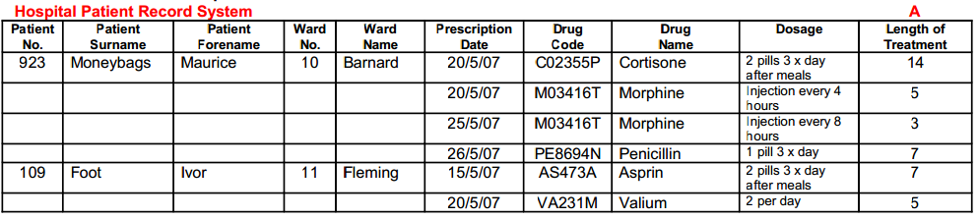
Let us start conceptually
Key concepts are:
Patient
Ward
Drug
Prescription

Slide 3
Conceptual Ideas
Each Ward can have many Patients
Each Patient is on 1 Ward
Each Patient can have many prescriptions
Each Prescription is for many drugs
Each Drug can appear on many prescriptions

Slide 4
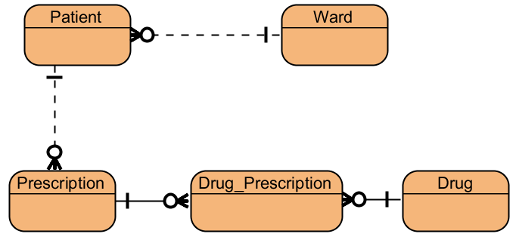

Slide 5
We start with a set of data, we need to turn it into uniformalised form by choosing a primary key
In this case, we will choose Patient Number

Slide 6
UNF
Patient No. Patient Surname Patient Forename Ward No. Ward Name Prescription Date Drug Code Drug Name Dosage Length of Treatment

Slide 7
UNF | 1NF
Patient No. Patient Surname Patient Forename Ward No. Ward Name Prescription Date Drug Code Drug Name Dosage Length of Treatment
Now, 1NF
We identify the repeating groups:
Which Columns have more than one value for the same primary key
Each group that repeats gets separated out into its own table

Slide 8
UNF | 1NF
Patient No. Patient Surname Patient Forename Ward No. Ward Name Prescription Date Drug Code Drug Name Dosage Length of Treatment
There is 1 repeating group:
Prescription Date
Drug Code
Drug Name
Dosage
Length of Treatment

Slide 9
UNF | 1NF
Patient No. Patient Surname Patient Forename Ward No. Ward Name Prescription Date Drug Code Drug Name Dosage Length of Treatment
What can we use as a primary key for this group?
Prescription Date
Drug Code
Drug Name
Dosage
Length of Treatment

Slide 10
In this case, we can’t use any one column. The combination of two or more is needed (composite key)
Prescription Date
Drug Code
Drug Name
Dosage
Length of Treatment
UNF | 1NF
Patient No. Patient Surname Patient Forename Ward No. Ward Name Prescription Date Drug Code Drug Name Dosage Length of Treatment

Slide 11
Also, add the original primary key as part of the new key
Patient Number
Prescription Date
Drug Code
Drug Name
Dosage
Length of Treatment
UNF | 1NF
Patient No. Patient Surname Patient Forename Ward No. Ward Name Prescription Date Drug Code Drug Name Dosage Length of Treatment

Slide 12
UNF | 1NF
Patient No. Patient Surname Patient Forename Ward No. Ward Name Prescription Date Drug Code Drug Name Dosage Length of Treatment | Patient No. Patient Surname Patient Forename Ward No. Ward Name Patient No. Prescription Date Drug Code Drug Name Dosage Length of Treatment

Slide 13
Now, we identify part key dependencies:
which columns do you need to know all parts of the key for?
And which can you find with only part of the key?
Patient No. Prescription Date Drug Code Drug Name Dosage Length of Treatment

Slide 14
Drug Name depends only on Drug Code
Everything else, you must know all 3 parts of the key
Patient No. Prescription Date Drug Code Drug Name Dosage Length of Treatment

Slide 15
UNF | 1NF | 2NF
Patient No. Patient Surname Patient Forename Ward No. Ward Name Prescription Date Drug Code Drug Name Dosage Length of Treatment | Patient No. Patient Surname Patient Forename Ward No. Ward Name Patient No. Prescription Date Drug Code Drug Name Dosage Length of Treatment | Patient No. Patient Surname Patient Forename Ward No. Ward Name Patient No. Prescription Date Drug Code Dosage Length of Treatment Drug Code Drug Name

Slide 16
3NF
Which bits of information don’t depend on the key in their table?
If we know the ward number, we know the ward name!

Slide 17
UNF | 1NF | 2NF
Patient No. Patient Surname Patient Forename Ward No. Ward Name Prescription Date Drug Code Drug Name Dosage Length of Treatment | Patient No. Patient Surname Patient Forename Ward No. Ward Name Patient No. Prescription Date Drug Code Drug Name Dosage Length of Treatment | Patient No. Patient Surname Patient Forename Ward No. Ward Name Patient No. Prescription Date Drug Code Dosage Length of Treatment Drug Code Drug Name | Patient No. Patient Surname Patient Forename Ward No.* Ward No. Ward Name Patient No. Prescription Date Drug Code Dosage Length of Treatment Drug Code Drug Name

Slide 18
Now check against our concepts, does it all make sense?
We have Patient
We have Drug
We have Ward
We have Prescription?

Slide 19
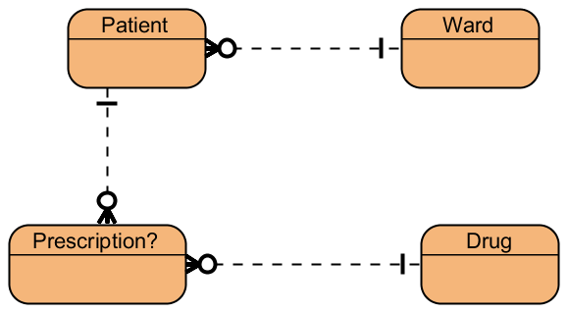

Slide 20
What the Test Covers?
Everything from the Practical sessions
You will be given a situation, with some data
You must normalise it to 3NF
You must then create those tables in MS Access and add the correct relationships
Your finished database file must be submitted on Breo

Slide 21
Student Records
The client has requested that you do not add any additional codes/id numbers. Only use the data they have provided.
You should be as efficient as possible, so only store data that you cannot calculate otherwise
Each assessment for each unit has a specific Type
Students can provide as many contact telephone numbers as needed
A grade of 40 or above is always a Pass
Unit Names and Course Names are always unique

Slide 22
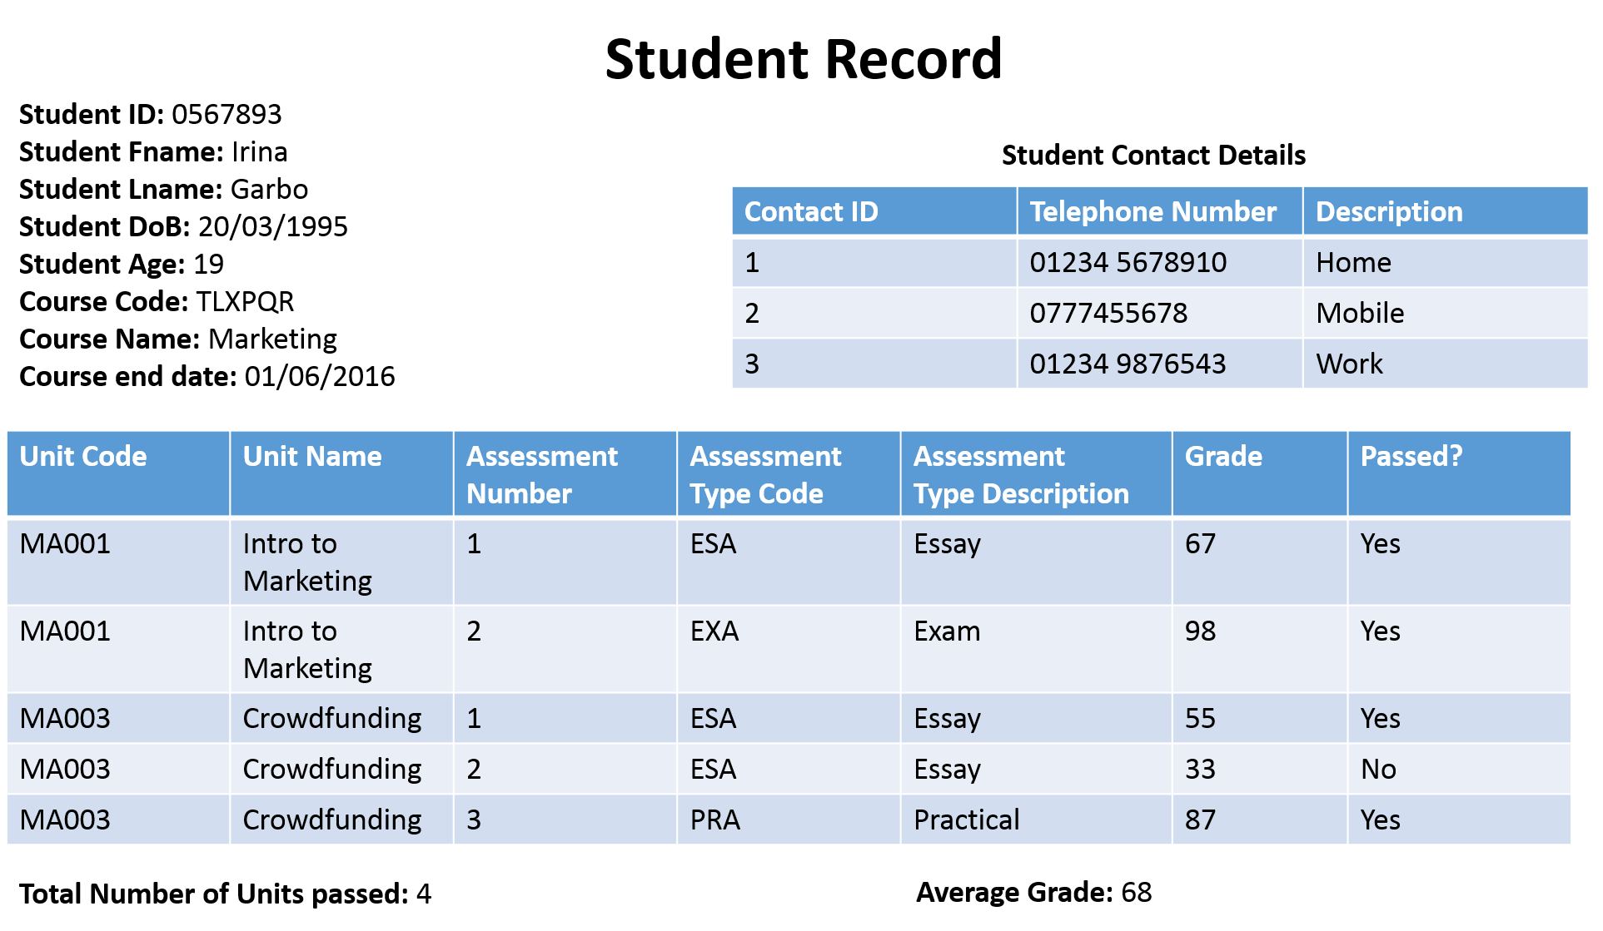

Slide 23
UNF | 1NF | 2NF | 3NF
Student ID Student Fname Student Lname Student DoB Course Code Course Name Course end date Contact ID Telephone Number Description Unit Code Unit Name Assessment Number Assessment Type Code Assessment Type Description Grade

Slide 25
UNF | 1NF | 2NF | 3NF
Student ID Student Fname Student Lname Student DoB Course Code Course Name Course end date Contact ID Telephone Number Description Unit Code Unit Name Assessment Number Assessment Type Code Assessment Type Description Grade | Student ID Student Fname Student Lname Student DoB Course Code Course Name Course end date Student ID Contact ID Telephone Number Description Student ID Unit Code Unit Name Assessment Number Assessment Type Code Assessment Type Description Grade

Slide 27
UNF | 1NF | 2NF | 3NF
Student ID Student Fname Student Lname Student DoB Course Code Course Name Course end date Contact ID Telephone Number Description Unit Code Unit Name Assessment Number Assessment Type Code Assessment Type Description Grade | Student ID Student Fname Student Lname Student DoB Course Code Course Name Course end date Student ID Contact ID Telephone Number Description Student ID Unit Code Unit Name Assessment Number Assessment Type Code Assessment Type Description Grade | Student ID Student Fname Student Lname Student DoB Course Code Course Name Course end date Student ID Contact ID Telephone Number Description Student ID Unit Code Assessment Number Grade Unit Code Unit Name Unit Code Assessment Number Assessment Type Code Assessment Type Description

Slide 29
UNF | 1NF | 2NF | 3NF
Student ID Student Fname Student Lname Student DoB Course Code Course Name Course end date Contact ID Telephone Number Description Unit Code Unit Name Assessment Number Assessment Type Code Assessment Type Description Grade | Student ID Student Fname Student Lname Student DoB Course Code Course Name Course end date Student ID Contact ID Telephone Number Description Student ID Unit Code Unit Name Assessment Number Assessment Type Code Assessment Type Description Grade | Student ID Student Fname Student Lname Student DoB Course Code Course Name Course end date Student ID Contact ID Telephone Number Description Student ID Unit Code Assessment Number Grade Unit Code Unit Name Unit Code Assessment Number Assessment Type Code Assessment Type Description | Student ID Student Fname Student Lname Student DoB Course Code* Course Code Course Name Course end date Student ID Contact ID Telephone Number Description Student ID Unit Code Assessment Number Grade Unit Code Unit Name Unit Code Assessment Number Assessment Type Code* Assessment Type Code Assessment Type Description

Slide 30
